Slide 1
New Employee Safety Orientation
General Industry
October 2024
Notes:
Presenter Notes
This training contains several training videos. You will need your username and password to access Summit’s online safety training videos, provided by Streamery. Visit our website to request login credentials.

Slide 2
Injury Statistics
5,190 fatal work injuries were recorded in the United States in 2021.¹
Transportation incidents were the leading cause of death in 2021, resulting in 38% of all work-related deaths.²
114,430 workers with less than three months of job tenure sustained a workplace injury or illness that required time off work in 2020.³
References
www.bls.gov/news.release/pdf/cfoi.pdf
injuryfacts.nsc.org/work/work-overview/top-work-related-injury-causes/data details/#:~:text=While%20transportation%20incidents%20are%20the,involving%20days%20away%20from%20work
https://www.shrm.org/topics-tools/employment-law-compliance/new-employees-risk-workplace-injuries
Notes:
Talking Points
There were 5,190 fatal work injuries recorded in the United States in 2021.
While transportation incidents are the leading cause of death in 2021, resulting in 38% of all work-related deaths, they are the fifth leading cause of nonfatal injuries in 2020 (latest data available), accounting for only about 3% of injuries or illnesses involving days away from work. In 2020, the leading cause of nonfatal work-related injuries or illnesses involving days away from work is exposure to harmful substances or environments, accounting for 36% of injuries or illnesses.
A recent Bureau of Labor Statistics’ Lost-Work Time Injuries and Illnesses Report states that employees with fewer than 6 years of employment make up only 31 percent of the workforce, but account for 38 percent of all illnesses and injuries sustained.
Maintaining a safe workplace is in the company’s best interest. Your company cares about you and wants you to be well and safe.
Presenter Notes
Ask participants why they think new employees experience a disproportionately high number of incidents. Cite workplace statistics or case studies about new employee incidents; maintain confidentiality. Discuss your organization’s official safety goals for protecting employees from these statistics.

Slide 3

Your Role in Safety
    Our goal as a company is to achieve safe work practices to help create a safe environment for everyone. Your role in safety is to:
    Participate in safety training.
    Identify hazards.
    Report hazards, incidents and near misses.
    Maintain an attitude of safety.
    Ask for help.
Reference: www.osha.gov/safety-management/worker-participation
Notes:
Talking Points
You play an important role in the safety of this workplace.
The goal of our safety policy is to ensure an accident-free workplace.
To achieve this goal, we need you to:
Continue to participate in all required safety training sessions.
Report any hazards and unsafe conditions you see. Report any incidents and near misses that occur. We need to know about problems, so that we can investigate their causes and make necessary changes.
Remember that you play a big role in the successful implementation of safety in our organization. Always keep a safety attitude and encourage others to also.
Ask your supervisor for help any time you are not sure how to proceed safely.
Make sure you’re familiar with your facility’s written safety policy. Know where to obtain and how to fill out hazard or accident report forms.
Presenter Notes
Describe your organization’s written safety policy. Hand out the policy or refer to it in the employee manual. Describe your company’s safety record. Emphasize improvements in reducing accidents and ongoing efforts to make the workplace safer. Hand out or refer to your organization’s hazard report and accident report forms.

Slide 4

Hand Tool Safety
Keep all tools in good condition with regular maintenance.
Use the right tool for the job.
Examine each tool for damage before use and do not use if damaged.
Operate each tool according to the manufacturer’s instructions.
Use correct personal protective equipment when operating tools.
Reference: www.osha.gov/sites/default/files/publications/osha3080.pdf
Notes:
Discuss company-specific policies/rules regarding hand tools.

Slide 5
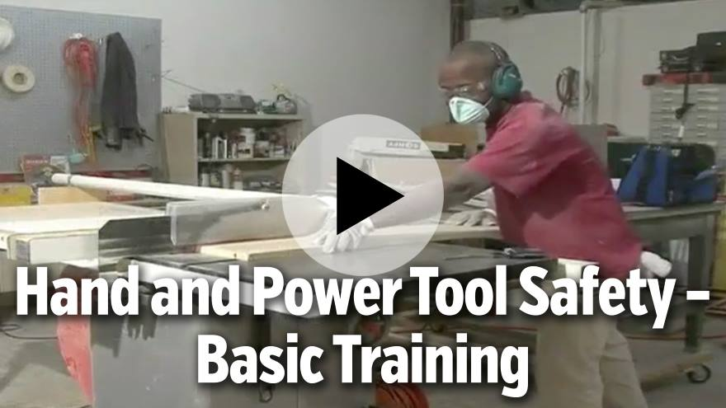
Reference: https://learn.streamery.co/Topics/Safety/OSHA-Compliance/Hand-Power-Tool-Safety/Hand-and-Power-Tool-Safety-Basic-Training-en
Notes:
You will need your username and password for Summit’s online safety training videos, provided by Streamery. Visit our website to request login credentials.

Slide 6
Hand Tools Cause 10–15% of Lost-Time Incidents
Wrench: Use the proper wrench for the job and with the jaws in the direction of the pull. Never use it as a hammer.
Knife: Cut away and never toward your body. Knives and hand stones used to sharpen them should be equipped with disc guards to protect fingers.
Hammer: A machinist ball or cross and straight peen hammer are not suitable for driving nails; a carpenter’s claw hammer is not suitable for a machinist’s work.
Screwdriver: Do not use as a wedge, chisel or punch. They should have proper handles and points in good condition.
Reference: https://www.summitholdings.com/www_media/site/files/b4b70174-29d2-4a3e-89ba-0f260a2f1e82.pdf
Notes:
Discuss company-specific policies/rules regarding hand tools.

Slide 7

Hammer Inspection
Make sure it is free of oil, grease and accumulated foreign material.
Check for damaged edges or irregularities on the striking surface.
Make sure the head is securely fastened to the handle.
Observe for any visible cracks in the head or handle.
Reference: www.osha.gov/sites/default/files/publications/osha3080.pdf
Notes:
Discuss company-specific policies/rules regarding hand tools.

Slide 8

Wrench Inspection
Observe the jaws to see if they are worn, damaged or out of proper alignment.
For tools with ratcheting mechanisms, does the ratchet operate properly and freely?
Make sure the adjusting nut of an adjustable wrench moves freely.
Check for any visible cracks in the jaws or handle.
Reference: www.osha.gov/sites/default/files/publications/osha3080.pdf
Notes:
Discuss company-specific policies/rules regarding hand tools.

Slide 9
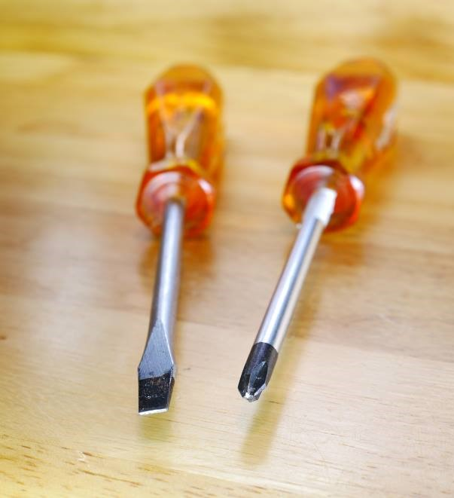
Screwdriver Inspection
Make sure the tip isn’t broken or worn.
Does the tip fit the screw snugly?
Check for any visible cracks in the tip, shaft or handle.
Reference: www.osha.gov/sites/default/files/publications/osha3080.pdf
Notes:
Discuss company-specific policies/rules regarding hand tools.

Slide 10

Pliers Inspection
Make sure the gripping surfaces of the jaws aren’t worn, damaged or out of alignment.
Check the hinge of the pliers to make sure it moves freely.
For pliers with expandable hinges, confirm the hinge locks securely in place when the jaws are expanded.
Check for any visible cracks in the jaws or handle.
Reference: www.osha.gov/sites/default/files/publications/osha3080.pdf
Notes:
Discuss company-specific policies/rules regarding hand tools.

Slide 11
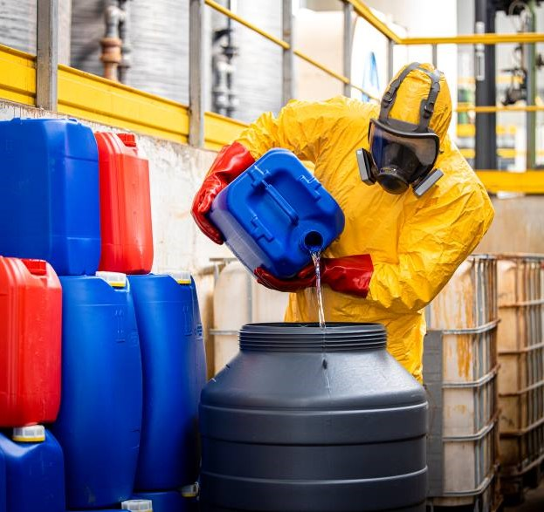
Personal Protective Equipment and Clothing
  Wear required personal protective equipment (PPE).
  Wear PPE in required work areas, even if only passing through.
  Ensure equipment and clothing fit correctly.
  Inspect and maintain PPE properly.
  Store PPE properly.
Reference: www.osha.gov/personal-protective-equipment
Notes:
Talking Points
Personal protective equipment and clothing are required for certain jobs. Make sure you know when and where you’re required to wear PPE in our facility. Also, make sure you know how to get a good fit and how to inspect, maintain and store PPE.
In our workplace:
Wear required PPE at all times. Your supervisor will issue your PPE and give you specific instructions and training for safe and proper use.
Wear PPE in required areas, such as forklift areas, warehouses or delivery docks, even if you’re only passing through. It takes only a second for an object to fall from a shelf and injure you.
Inspect your PPE before every use.
Get a good fit with your PPE. Make sure it completely covers the areas to be protected and is comfortable.
Maintain PPE according to workplace schedules and procedures.
Store PPE properly according to company procedures.
Presenter Notes
If you did a tour of your workplace before the session, remind participants of the areas they passed through that required PPE. Bring samples of PPE that your workplace requires. Demonstrate or have a participant demonstrate how to get a proper fit for PPE, such as a hard hat or hearing protection. Describe your organization’s inspection, maintenance and storage procedures for PPE.

Slide 12
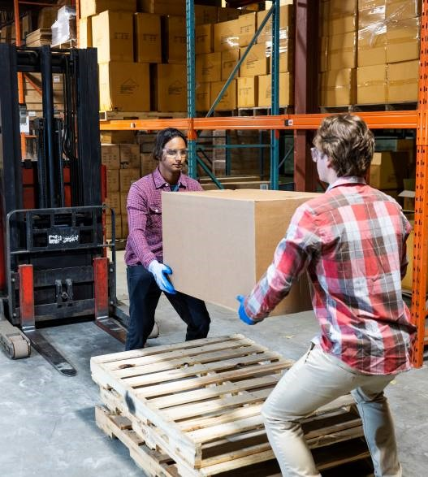
Lifting and Carrying Safely
Use a lifting aid when possible.
Never lift beyond your strength. Ask for help.
Always crouch down to what you are going to lift. Don’t bend over to the load.
Secure a good footing, placing your feet about shoulder width apart.
Resource: https://injuryfacts.nsc.org/work/work-overview/top-work-related-injury-causes
Reference: www.osha.gov/etools/electrical-contractors/materials-handling/heavy
Notes:
Additional resource
Visit our website to access a safe lifting poster
Talking Points
Overexertion and bodily reaction are the second leading cause of missed workdays (21.7%) This includes:
Non-impact injuries: Resulting from excessive physical effort directed at an outside source; common activities include lifting, pushing, turning, holding, carrying, or throwing
Repetitive motion: Microtasks resulting in stress or strain on some part of the body due to the repetitive nature of the task, typically without strenuous effort such as heavy lifting
Take these steps to prevent back injuries.
When moving a load assess its size, weight and bulk. Ask for help if it’s too big, heavy or awkward. Or use material-handling equipment, which we will cover on the next slide.
If the load is manageable for you alone, use these safe lifting techniques:
Bend at the knees, not the waist.
Pull load close to your body.
Face your load as you lift. Don’t twist your body while lifting.
Let your legs do the lifting by holding the load close to your body and standing up with your back straight.
Don’t overextend when you reach for items. Move your whole body closer to objects.
Finally, use a footrest when sitting for long periods.
Presenter Notes
Demonstrate or have a participant demonstrate safe lifting techniques. Modify the slide to discuss whether your facility has areas where footrests may be used.

Slide 13
Lifting and Carrying Safely (Continued)
Lift gradually. Don’t jerk upward.
Avoid twisting motions by shifting the position of your feet.
Lift by standing up or pushing up with your leg muscles. This takes the strain off your back muscles.
To put down a load, generally reverse the above methods.
Resource: https://injuryfacts.nsc.org/work/work-overview/top-work-related-injury-causes
Reference: www.osha.gov/etools/electrical-contractors/materials-handling/heavy
Notes:
Additional resource
Visit our website to access a safe lifting poster
Talking Points
Overexertion and bodily reaction are the second leading cause of missed workdays (21.7%) This includes:
Non-impact injuries: Resulting from excessive physical effort directed at an outside source; common activities include lifting, pushing, turning, holding, carrying, or throwing
Repetitive motion: Microtasks resulting in stress or strain on some part of the body due to the repetitive nature of the task, typically without strenuous effort such as heavy lifting
Take these steps to prevent back injuries.
When moving a load assess its size, weight and bulk. Ask for help if it’s too big, heavy or awkward. Or use material-handling equipment, which we will cover on the next slide.
If the load is manageable for you alone, use these safe lifting techniques:
Bend at the knees, not the waist.
Pull load close to your body.
Face your load as you lift. Don’t twist your body while lifting.
Let your legs do the lifting by holding the load close to your body and standing up with your back straight.
Don’t overextend when you reach for items. Move your whole body closer to objects.
Finally, use a footrest when sitting for long periods.
Presenter Notes
Demonstrate or have a participant demonstrate safe lifting techniques. Modify the slide to discuss whether your facility has areas where footrests may be used.

Slide 14
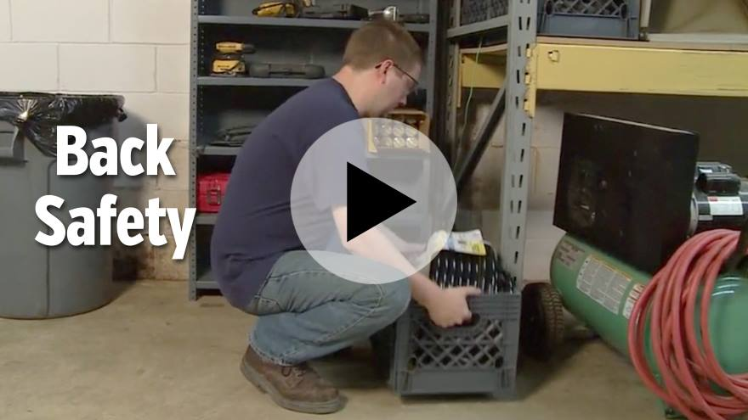
Reference: https://learn.streamery.co/Topics/Safety/Workplace-Safety/Back-Injury-Prevention/Back-Safety
Notes:
You will need your username and password to access Summit’s online safety training videos, provided by Streamery. Visit our website to request login credentials.

Slide 15
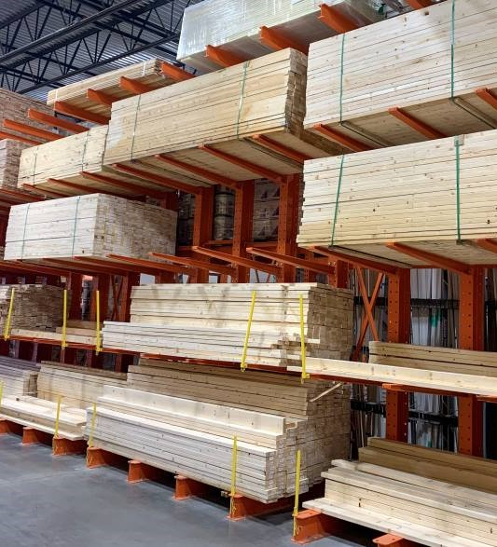
Material Storage Safety
Only stack objects to a safe height and ensure that the stack will remain steady.
Maintain at least 18 inches between the stack and any sprinkler heads.
Maintain a minimum of three feet clearance around electrical panels and service entries.
Keep storage areas free from accumulated material that can cause tripping, fire and explosion or contribute to the harboring of pests.
Reference: www.osha.gov/sites/default/files/publications/osha2236.pdf

Slide 16
Material Storage Safety (Continued)
Store compressed gas cylinders on a smooth floor in an upright position with valve covers in place.
Cylinders should be fastened to a wall or stable surface to prevent displacement.
Materials should never be stored under stairs or within exit enclosures.
No item should be stored in stairways to impede egress.
Reference: www.osha.gov/sites/default/files/publications/osha2236.pdf

Slide 17

Reference: https://learn.streamery.co/Topics/Safety/OSHA-Compliance/Lockout-Tagout/Lockout-Tagout-Controlling-Hazardous-Energy
Notes:
You will need your username and password to access Summit’s online safety training videos, provided by Streamery. Visit our website to request login credentials.

Slide 18

Material Handling Safety
  Assess your load and route.
  After proper training, choose the right equipment for the job:
    Hand truck
    Powered equipment
    Conveyor
    Hoist and derrick
  Load equipment safely.
  Push—don’t pull.
  Wear appropriate personal protective equipment.
Reference: www.osha.gov/sites/default/files/publications/osha2236.pdf
Notes:
Talking Points
Use material-handling equipment to make your job easier and safer. Follow these steps:
Assess the load you need to move and the distance you need to move it to determine what equipment to use.
Choose the right equipment.
Hand trucks, dollies and carts put wheels and a platform under your load.
Powered vehicles, such as forklifts, move large loads and require documented special OSHA-related training prior to operating any powered equipment.
Conveyors move loads through the company.
Hoists and derricks require special training.
Load material-handling equipment safely.
Place heavy objects on the bottom, with the load over the wheel axles.
Stack lighter objects on top to a height well below eye level.
Secure bulky, loose or delicate objects with ties or cords.
Push material-handling equipment. Don’t pull it, because you increase the risk of injuring your back, arms or legs.
Finally, wear the appropriate personal protective equipment for the load or area. You may need gloves, safety shoes or a hard hat in loading docks, for example.

Slide 19
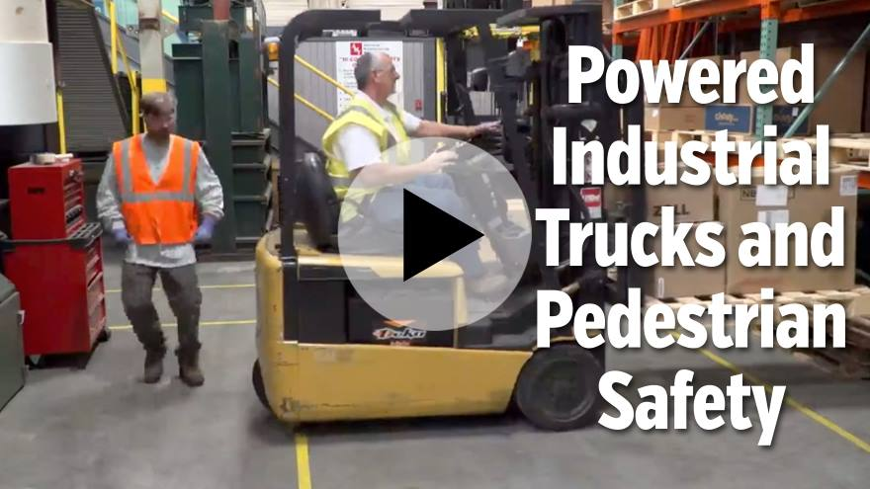
Reference: https://learn.streamery.co/Topics/Safety/OSHA-Compliance/Forklift-Safety/To-The-Point-About-PITs-and-Pedestrian-Safety
Notes:
You will need your username and password to access Summit’s online safety training videos, provided by Streamery. Visit our website to request login credentials.

Slide 20

Ladder Safety
Maintain three points of contact while ascending or descending a ladder.
Face the ladder when ascending, descending or working.
Use the correct ladder for the job and ensure that it is sturdy enough to hold the load.
Make sure the ladder is stable.
Inspect ladders before use. Check for loose, cracked, bent, missing or broken steps/rungs, rails and non-slip feet.
Damaged or worn ladders must be destroyed.
Reference: www.osha.gov/sites/default/files/publications/osha3124.pdf
Notes:
Discuss company-specific policies/rules regarding ladders.

Slide 21
Ladder Inspection
Inspect for damage, lack of structural integrity, missing components or loose parts.
The steps or rungs must be tight and secure to the side rails.
All hardware and fittings must be properly and securely attached.
Test movable parts to make sure they operate without binding or too much free play.
Reference: www.dir.ca.gov/dosh/etools/08-001/care.htm

Slide 22
Ladder Inspection (Continued)
All labels should be intact and readable.
Ladders should be free of oil, grease and slippery materials.
A ladder exposed to fire or strong chemicals must be discarded.
Leg levelers, paint shelves, stand-off shelves, etc. must be in good condition.
The base must be on secure and level footing. Use a ladder leveler for equal rail support on uneven surfaces.
Reference: www.dir.ca.gov/dosh/etools/08-001/care.htm

Slide 23
Ladder Inspection (Continued)
The base must have slip resistant material.
Ropes and pulleys must be in good condition.
Ladder extension locks must move freely and lock correctly.
Check for rung locks on the rails of the top section to ensure it will not fall.
Extension guide brackets must be secure and in place.
Reference: www.dir.ca.gov/dosh/etools/08-001/care.htm

Slide 24

Reference: https://learn.streamery.co/Topics/Safety/OSHA-Compliance/Ladder-Safety/A-Practical-Approach-to-Ladder-Safety-Concise-en
Notes:
You will need your username and password to access Summit’s online safety training videos, provided by Streamery. Visit our website to request login credentials.

Slide 25

Hazard Communication
Hazardous materials present great risks. You have a right to know what materials are used in the workplace and what hazards they present.
A list of hazardous materials used in this facility will be provided for your review.
All containers must be labeled with safety information that lists the contents, name and address of manufacturer or importer and specific hazards, including the degree of hazard.
Reference: www.osha.gov/sites/default/files/publications/OSHA3514.pdf
Notes:
Talking points
Hazardous materials present great risks to your safety and health. For that reason:
You have a right to know what materials are used in this workplace and what hazards they present.
We keep a list of hazardous materials used in our facility. Ask your supervisor to see it at any time.
Container labels must all contain a variety of safety information, including the material’s identity, name and address of manufacturer or importer and specific hazards including the degree of hazard.
We also keep safety data sheets for every chemical used in our facility. You can access them at any time. Safety data sheets contain even more safety details. You are required to read the label and the safety data sheets before using any chemical in our facility.
Make sure you know where to access our facility’s hazardous materials list and safety data sheets. Also, make sure you know how to read labels and safety data sheets.
Presenter notes
Tell participants where they can get your facility’s hazardous materials list. Tell participants where they can get safety data sheets for your facility’s hazardous materials. Bring a container and discuss the information on its label. Bring a safety data sheet and discuss its sections and the information it contains. Delete this slide if your facility does not have hazardous materials requirements.

Slide 26
Hazard Communication (Continued)
A safety data sheet (SDS) with safety details is kept for every chemical used in our facility and can be accessed at any time.
Learn where to access our facility’s hazardous materials list and SDS and how to read them correctly.
Know where eyewash stations and showers are located.
Read the container label and its appropriate SDS before using any chemical.
Reference: www.osha.gov/sites/default/files/publications/OSHA3514.pdf
Notes:
Talking points
Some other things you need to know about hazardous materials:
Ask your supervisor or the safety supervisor whenever you have questions about materials, container labels or safety data sheet information.
Make sure you know whom to contact for your hazardous material questions and for reporting of spills and leaks.
Report a spill immediately, but do not attempt to clean it up. Spills may be cleaned up only by trained personnel.
OSHA has specific disposal requirements. You will receive training if you are going to work with these substances. If you are not trained in disposal, let authorized personnel take care of it.
Presenter notes
Give participants contact information for their questions. Tell participants to whom to report spills and who is authorized to clean them up. Tell participants who is authorized to dispose of materials. Delete this slide if your facility does not have hazardous material requirements.

Slide 27
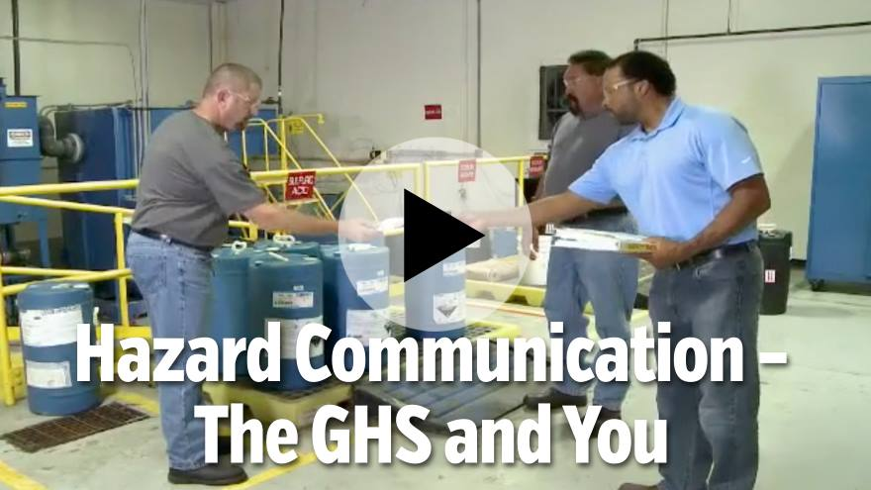
Reference: https://learn.streamery.co/Topics/Safety/OSHA-Compliance/HazCom-Right-to-Know/Hazard-Communication-The-GHS-You-Concise-en
Notes:
You will need your username and password to access Summit’s online safety training videos, provided by Streamery. Visit our website to request login credentials.

Slide 28
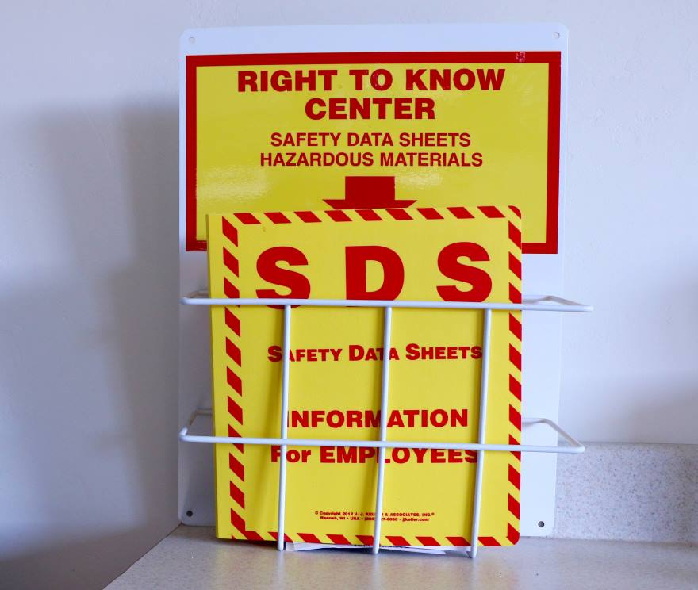
Know Where to Find Safety Data Sheets
Sections 1–8 contain general information about the chemical, identification, hazards, composition, safe handling practices and emergency control measures (e.g., fire fighting) to help those who need the information quickly.
Sections 9–11,16 contain technical and scientific information, such as physical and chemical properties, stability and reactivity information, toxicological information and exposure control information.
Reference: www.osha.gov/sites/default/files/publications/OSHA3514.pdf
Notes:
Provide employee with information on where safety data sheets are located within the facility

Slide 29

Good Housekeeping
  Practice good housekeeping in your work area. You are responsible for keeping your area organized.
  Report areas in need of attention to your supervisor or a member of the safety committee. Clean up spills immediately.
  Return tools and other equipment to their proper storage place after use.
  Place empty boxes or wrappings in a cart or trash container to eliminate tripping hazards.
Reference: www.osha.gov/laws-regs/regulations/standardnumber/1915/1915.81
Notes:
Talking points
Housekeeping is a vital part of our safety program, because good housekeeping greatly reduces hazards. Here’s how to clean house:
Store all tools and materials in their places to help keep clear access to evacuation routes, emergency exits, firefighting equipment, first-aid stations and electrical panels.
Keep walkways and stairwells clear to prevent slips, trips, and falls, back injuries and broken bones.
Close drawers and doors to prevent tripping, bumping and scraping injuries.
Dispose of trash promptly and properly to prevent the accumulation of combustible materials, such as paper, cardboard and rags.
Make sure you follow our facility’s specific housekeeping procedures.
Presenter notes
Discuss site-specific housekeeping hazards at your workplace, such as wet-floor areas or high-traffic delivery areas where packages tend to accumulate in walkways.

Slide 30
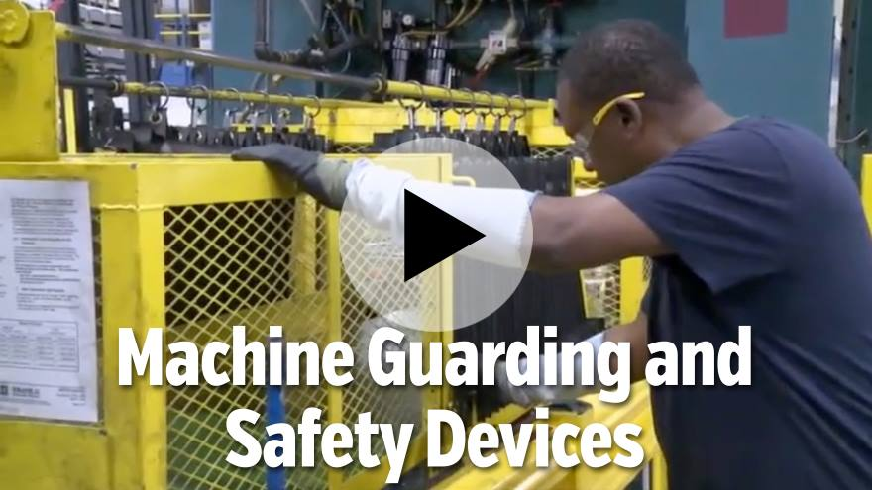
Reference: https://learn.streamery.co/Topics/Safety/OSHA-Compliance/Machine-Guarding/To-The-Point-About-Machine-Guarding-And-Safety-De
Notes:
You will need your username and password to access Summit’s online safety training videos, provided by Streamery. Visit our website to request login credentials.

Slide 31
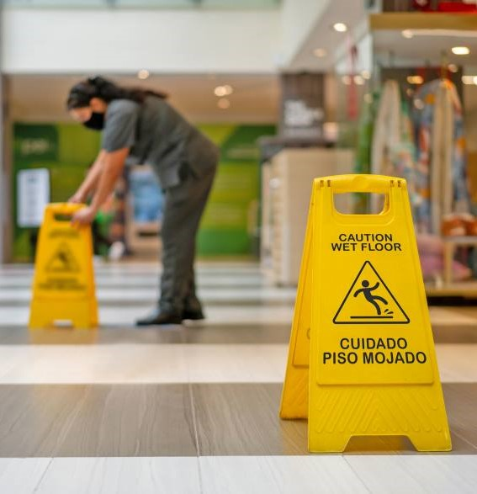
Slip, Trip and Fall Hazards
  Power cords, ropes and hoses across floors and walkways.
  Open-sided walkways and platforms.
  Clutter in walkways.
  Floor damage or holes and openings in walls.
  Open pits, tanks, vats and ditches.
  Wet floors or stairs.
Reference: 29 C.F.R. §§ 1910.21, 1910.22, 1910.25, 1910.28, 1910.29 & 1910.30 (2024).
Notes:
Presenter Notes
Modify this slide to describe slip, trip or fall hazards at your facility. Ask trainees to describe their own experiences with slip, trip and fall hazards. Have them identify specific hazards that they are aware of.

Slide 32
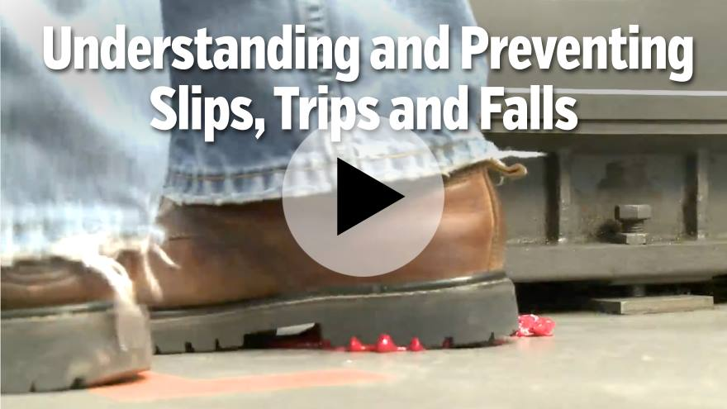
Reference: https://learn.streamery.co/Topics/Safety/OSHA-Compliance/Slips,-Trips,-Falls/Understanding-and-Preventing-Slips,-Trips-and-Falls
Notes:
You will need your username and password to access Summit’s online safety training videos, provided by Streamery. Visit our website to request login credentials.

Slide 33

Safe Driving Tips
  Plan your route ahead of time and allow plenty of travel time.
  Use a seatbelt at all times.
  Keep your lights on and use turn signals.
  Be alert to situations requiring quick action.
  Avoid distractions and do not text while driving.
  Make sure your vehicle is inspected regularly.
Reference: www.osha.gov/sites/default/files/publications/Safe_Driving_Practices.pdf
Notes:
Talking points
Thousands of accidents occur each year in commercial motor vehicles—and in noncommercial vehicles used in the workplace. Here are some general points you should remember about defensive driving:
Inspect and maintain your vehicle.
Know driving hazards and dangerous conditions.
Back into parking spots—it’s safer than backing out.
Wear your seat belt.
Follow safe driving practices in all driving conditions.
Keep your lights on when necessary and use turn signals.
Know how to respond to emergencies.
No texting while driving.

Slide 34
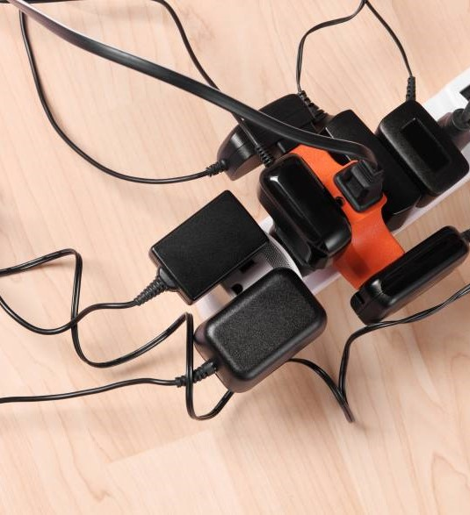
Basic Electrical Safety
Damaged outlets and loose or missing covers should be replaced immediately.
Report any exposed wiring.
Use ground-fault circuit interrupter (GFCI) outlets near sinks.
Keep electrical panels closed and clear of obstruction.
Wear correct PPE.
Inspect electrical cords for exposed wires or missing ground plug.
Reference: www.summitholdings.com/site/tp/ELECTRICAL_SAFETY
Notes:
Talking points
Here are common electrical hazards, along with the steps you can take to prevent them.
Electrical hazards include: Overloaded outlets, frayed wires or cords, malfunctioning equipment and extension cords that aren’t rated for the equipment load. Don’t use any of these items and report problems to your supervisor.
Make sure you know the specific electrical hazards in our facility and what you can do to prevent injuries.
Presenter notes
Modify this slide to describe the electrical hazards that are present in your facility.

Slide 35
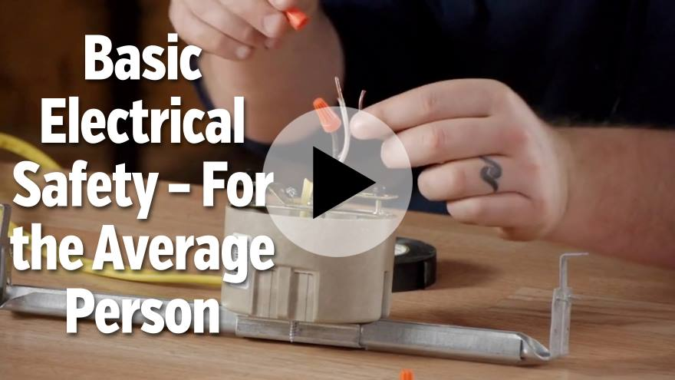
Reference: https://learn.streamery.co/Topics/Safety/OSHA-Compliance/Electrical-Safety/Basic-Electrical-Safety-For-the-Average-Person
Notes:
You will need your username and password to access Summit’s online safety training videos, provided by Streamery. Visit our website to request login credentials.

Slide 36

Common Fire Hazards
  Office equipment and supplies
  Electrical wires and equipment
  Flammable materials
Reference: www.osha.gov/fire-safety/hazards-solutions
Notes:
Talking points
Here are common fire hazards, along with the steps you can take to prevent them.
To avoid office hazards, promptly dispose of paper and cardboard and keep these items away from hot equipment such as copiers, printers and space heaters. Do not smoke in “No Smoking” areas.
Electrical hazards include: Overloaded outlets, frayed wires or cords, malfunctioning equipment and extension cords that aren’t rated for the equipment load. Don’t use any of these items and report problems to your supervisor.
Material hazards include: Flammable liquids, such as oil, gas, kerosene; many solvents and waste paper. Compressed flammable gases have flashpoints below room temperatures. You will receive specific training if you handle or work around any of these materials.
Make sure you know the specific fire hazards in our facility and what you can do to prevent fires.
Presenter notes
Modify this slide to describe the fire hazards that are present in your facility.

Slide 37
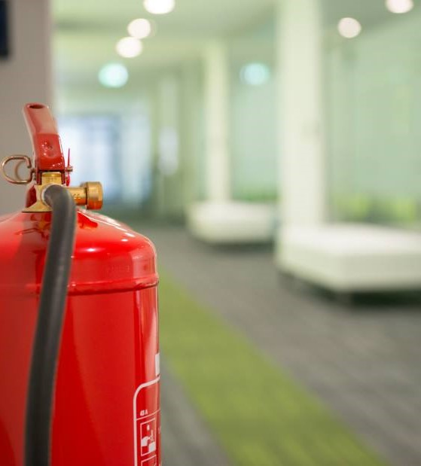
Fire Response
  Know where fire extinguishers are located.
  Use the right extinguisher for the job.
  Know how to use a fire extinguisher:
    Pull the pin
    Aim hose at fire base
    Squeeze trigger
    Sweep hose back and forth
Reference: www.osha.gov/laws-regs/regulations/standardnumber/1926/1926.150
Notes:
Talking points
If you are trained and authorized to use a fire extinguisher, take these steps to respond to fires:
Make sure you know where the nearest fire extinguisher is to your work area at all times. Note the location of extinguishers whenever you work in a new area, even if only temporarily.
Be sure the extinguisher is designed to fight the type of fire you have. For example, only certain extinguishers can be used for electrical fires. Check the label to be sure.
To use a fire extinguisher, remember the acronym “PASS.”
Pull the pin.
Aim the hose at the base of the fire.
Squeeze the trigger to release fire-retardant material.
Sweep the hose back and forth low across the fire.
Make sure you know how to use the fire extinguishers in our facility.
Presenter notes
If you took a tour before this session, remind participants where the fire extinguishers are located. If not, use a site map to point them out. Bring a fire extinguisher and demonstrate how to use it or ask a participant to come up and demonstrate it.

Slide 38
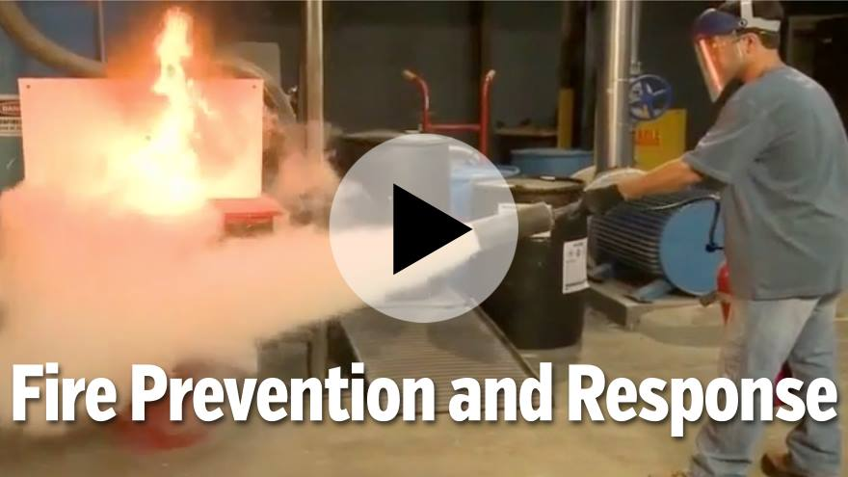
Reference: https://learn.streamery.co/Topics/Safety/OSHA-Compliance/Fire-Evacuation-Prevention/To-The-Point-About-Fire-Prevention-Response
Notes:
You will need your username and password to access Summit’s online safety training videos, provided by Streamery. Visit our website to request login credentials.

Slide 39

First Aid Response
Contact a trained first-aid provider if someone is injured.
Use eye wash stations for chemical exposure to eyes.
Locate the first-aid box near your work area.
Consult the safety data sheet if exposed to spills or chemical releases.
Protect against blood-borne pathogens.
Reference: www.osha.gov/laws-regs/regulations/standardnumber/1910/1910.151

Slide 40

Evacuation Procedures
  Recognize evacuation
  signals.
  Listen for instructions.
  Shut down equipment.
  Follow nearest safe exit route.
  Proceed to assembly area.
Reference: www.osha.gov/etools/evacuation-plans-procedures/eap/minimum-requirements
Notes:
Talking points
There are several reasons we may need to evacuate our facility. In all cases, follow workplace evacuation procedures.
Recognize our evacuation signal.
Listen for special evacuation instructions.
Shut down equipment in your area with emergency stop controls.
Follow the nearest safe evacuation route. Avoid elevators. If your first exit route is full of smoke or otherwise obstructed, use the next nearest route.
Proceed immediately to the designated assembly area. Walk, don’t run. Report to the supervisor in charge when you arrive so that everyone can be accounted for in a quick and orderly manner. Do not leave the assembly area until told to do so.
Know our evacuation plans. In our facility, where do we meet in case of an emergency, such as a tornado, fire or hurricane?
Presenter notes
Modify this slide to give site-specific information on the exit routes and designated meeting places for every area of the facility. Describe the evacuation signal or combination of signals that your workplace uses. Hand out your organization’s written evacuation plan or refer to it in the employee manual.

Slide 41
New Employee Orientation Tour
First-aid kit location and instructions
Eye wash station location and instructions
Fire extinguisher location and instructions
Entry and exit points
Evacuation plan and routes
Area hazards (furnace or confined space)
PPE required areas
Notes:
Finally, prior to beginning your first day of work we will give you a tour of the facility and work areas to identify the items noted above.

Slide 42

Pamphlet Review

Slide 43

Your Safety Orientation Is Complete
Any Questions?
Notes:
This concludes our training session.

Slide 44
Summit is a leading regional provider of workers’ compensation services with more than 40 years of experience.
Visit summitholdings.com to learn more.
The information presented in this publication is intended to provide guidance and is not intended as a legal interpretation of any federal, state or local laws, rules or regulations applicable to your business. The loss prevention information provided is intended only to assist policyholders of Summit managed insurers in the management of potential loss producing conditions involving their premises and/or operations based on generally accepted safe practices. In providing such information, Summit Consulting LLC does not warrant that all potential hazards or conditions have been evaluated or can be controlled. It is not intended as an offer to write insurance for such conditions or exposures. The liability of Summit Consulting LLC and its managed insurers is limited to the terms, limits and conditions of the insurance policies underwritten by any of them.
5/24 (23-292) © 2024 Summit Consulting LLC (DBA Summit. Know the people who know workers’ comp. LLC) PO Box 988, Lakeland, FL 33802. All rights reserved.

